Slide 1
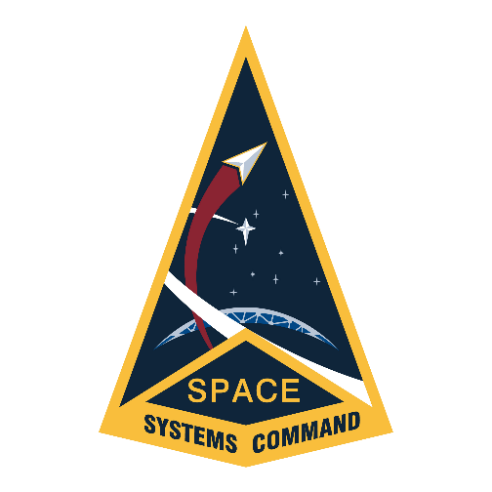
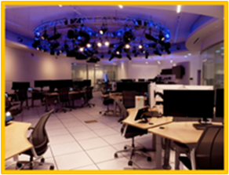
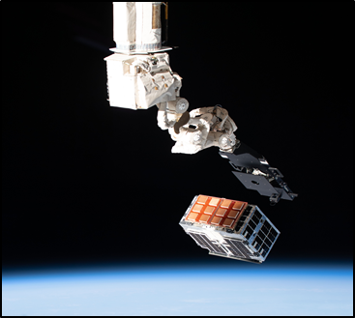
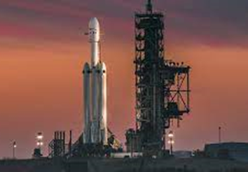
Innovation and Prototyping
Acquisition Delta
SPACE SYSTEMS COMMAND
Innovation and Prototyping (I&P) Delta leads the way on enabling and delivering next-generation space enterprise solutions through rapid, innovative and affordable technology that leverages international, commercial, and interagency partnerships.
Located at Kirtland Air Force Base, NM, with operating locations at Schriever SFB, CO, Los Angeles AFB, CA, and NASA, Johnson Space Center, TX
I&P enables and prototypes emerging technologies in space and ground to accelerate the development of war-winning space capabilities for our National defense. I&P provides world-class mission design, systems engineering, prototyping, spacecraft acquisition, integration, launch and on-orbit operations.
I&P is supported by more than 900 government, military, FFRDC, and contractor personnel dedicated to driving innovation to deliver flexible, resilient and affordable warfighter capabilities in order to dominate the space domain.
Mission
Advance National Security Space Capabilities through
Experimentation, Innovation, & Prototyping
Vision
Out-Innovate the Threat!
#SpaceStartsHere

Slide 2
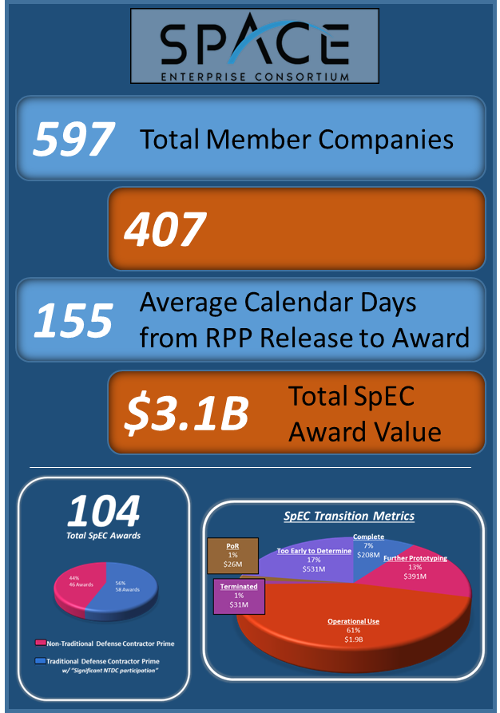
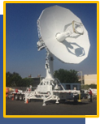
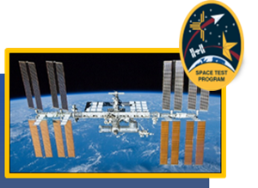
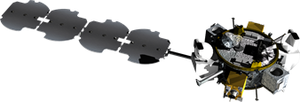
SPACE SYSTEMS COMMAND
Innovation and Prototyping
Acquisition Delta
FOR MORE INFORMATION
Visit the SSC Front Door website at: https://sscfrontdoor.experience.crmforce.mil/SSCFrontDoor/s/
SSC Front Door - Accessing Commercial Innovation
Space Enterprise Consortium (SpEC)
USSF’s acquisition tool for accelerating innovative prototyping
Expanding Space Access & Test Ecosystem
Space Test Program (STP)
“Pathfinders” for future systems: demonstrating innovative space access solutions
Accelerate technologies that enhance operational capabilities for Joint Warfighters
The single face to NASA for all DoD payloads on the International Space Station (ISS)
Research, Development, Test & Evaluation Support Complex (RSC)
Operates the USSF’s only 24/7 prototype satellite C2 operations
REPR Satellite Operations Center: Provides on-orbit experiments and prototyping, innovative concepts of operation development, and game-changing technology demonstration
Prototypes and operates emerging ground C2 systems in support of on-orbit missions
Mobile Range Operations
Provides in-garrison Tracking, Telemetry, and Command (TT&C) for
launch & booster activities; SCN resiliency
Investing in Resilient Architectures
Tetra
Small Sat to develop tactics, techniques, and procedures (TTP) and technologies to include rendezvous and proximity operations (RPO), docking, and refueling
LDPE/ROOSTER
Freight train to GEO…and a common bus
for experimentation, innovation, prototyping, and operations
#SpaceStartsHere

