Slide 1
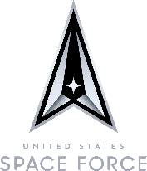
Space and Missile Systems Center
Space Systems Center
Innovation & Prototyping Directorate
The Innovation and Prototyping Directorate is headquartered at Kirtland Air Force Base, N.M. with operating locations at Los Angeles Air Force Base, CA, Johnson Space Center, Houston, TX, and three locations in Colorado; Schriever Space Force Base, Buckley Space Force Base, and Boulder, respectively. The directorate’s primary mission areas include rapid prototyping development, prototype space operations, worldwide deployable telemetry, tracking, and control, prototyping capability maturation, and executing the Department of Defense Space Test Program. As a direct report to the Space and Missiles Systems Center, Space Development Corps, the directorate is leading the way on enabling and delivering next-generation space enterprise solutions through rapid, innovative and affordable technology that leverages international, commercial, and interagency partnerships. The directorate consists of four mission divisions and four functional divisions, which include financial, personnel, contracting, and strategic capability support. With a combined workforce of over 940 personnel to include military, government civilians and support contractors, the team is committed in providing and fielding cutting-edge space capabilities in support of the United States Space Force (USSF) and our nation!
Space Test Program Division
The Space Test Program Division (SSC/DCIS) demonstrates emerging technologies in space to accelerate the development of war-winning space capabilities for the joint warfighter. Managed by the USSF’s Space and Missile Systems Center at Kirtland AFB, NM, the Space Test Program (STP) provides mission design, spacecraft acquisition, integration, launch and on-orbit operations support for DoD’s priority science and technology (S&T) experiments. As the primary agent for S&T payloads on multi-manifest missions flown on USSF and commercially procured launch vehicles, STP significantly expands space access while also delivering innovative space capabilities. At STP’s Johnson Space Center location in Houston, TX, STP manages all DoD payloads on the International Space Station, providing additional validation opportunities for cutting-edge space technology. Over 53 years, STP has executed 283 missions and provided space access for 623 DoD experiments, proving out technologies that are critical to our current operational space systems. STP continues to drive space innovation by testing novel approaches to orbit, expanding commercial and international partnerships, and enhancing fundamental space science.
Prototype Operations Division
The Prototype Operations Division (SSC/DCIO) operates the USSF’s premier prototype space operations center, providing expertise in ground system command and control development, test and evaluation, and satellite operations. SSC/DCIO portfolio includes the deployment of test equipment to manufacturing and launch sites to test satellites prior to launch; the worldwide deployment and operation of telemetry, tracking, and control assets; and the 24/7 operations of the Research and Development, Test and Evaluation Support Complex (RSC) at Kirtland AFB. The RSC provides an environment for effective and efficient satellite operations for a wide range of prototype, research & development, demonstration, and operational missions utilizing the revolutionary Multi-Mission Satellite Operations Center (MMSOC) Ground System Enterprise (GSE), which the division also sustains in-house. The MMSOC GSE enables SSC/DCI to conduct cutting edge, multi-satellite operations and tactic, techniques, and procedures to provide advance warfighter capabilities for next-generation space systems across the entire USSF portfolio.

Slide 2
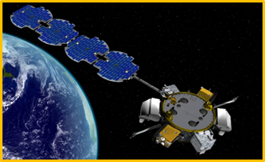
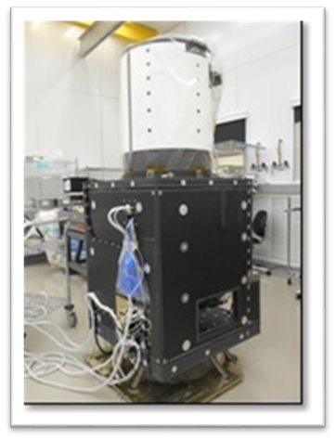
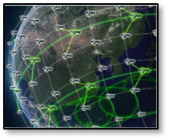
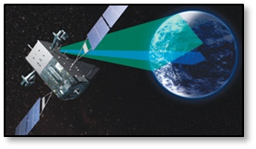
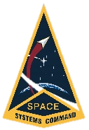
Space Systems Center
Rapid Development Division
The Rapid Development Division (SSC/DCIR) is focused on enabling and delivering the next generation of space enterprise solutions through rapid, innovative prototyping that leverages international, commercial, and interagency partnerships. Our teams rapidly deliver capabilities to the warfighter and enable the US to dominate in a multi-domain environment through development efforts in cross-cutting operationally relevant prototypes. SSC/DCIR is a bridge that takes USSF’s architecture requirements from concept to hardware and fields those initial technologies. The Division significantly expands "access to space" for critical technology development payloads, develops key on-orbit technologies aimed at warfighter readiness and operational relevance, and prototypes various architecture constructs such as proliferated low earth orbit. SSC/DCIR expands DoD industry engagement by sponsoring the Space Enterprise Consortium, which encourages industry partners, particularly non-traditional/small business vendors, to work with the DoD on fielding cutting-edge capabilities.
Advanced Development Division
The Advanced Development Division (SSC/DCIA) serves as the USSF agent for capability maturation in support of future space architectures. SSC/DCIA has three major focus areas: technology maturation, capability demonstration, and international partnerships. The technology maturation portfolio leads the way in space technology improvements through the development of test beds to support digital engineering and non-flight demonstrations. SSC/DCIA provides operationally relevant ground and on-orbit demonstrations designed to prove the operational feasibility of key technologies within infrared sensing; position, navigation, and timing; weather; space domain awareness; and, military satellite communications. By leveraging capabilities developed across SSC, SSC/DCIA is also providing the capability to partner internationally. These partnerships simultaneously increase the capabilities provided to the joint warfighter and improve architecture resiliency. SSC/DCIA provides development planning and concept development support to SSC program offices and the USSF to ensure future materiel solutions effectively close space superiority capability gaps.
Space Systems Center
The Space Systems Center (SSC) is located at Los Angeles Air Force Base in El Segundo, California. The mission of SSC is to pioneer, develop and deliver sustainable joint space warfighting capabilities to defend the nation and its allies and disrupt adversaries in the contested space domain. Its mission areas include launch acquisition & operations, space control, positioning, navigation & timing, missile warning, satellite communication, cross-mission ground command & control and data.
Protecting The Space Domain…
Enterprise Partnership Innovation Culture Speed

