Slide 1
Kirtland Air Force Base Bulk Fuels Facility Leak Cleanup Public Meeting November 2, 2022 (6:00—8:00 PM)
Sheen Kottkamp, Air Force Civil Engineer Center
Ryan Wortman, Air Force Civil Engineer Center

Slide 2
Discussion Topics
Status update: Ethylene Dibromide (EDB) interim corrective measure pump and treat
Status of EDB plume north of Ridgecrest Drive, SE
Volume of groundwater treated
Benzene Plume Stability
Recent Field work:
Quarterly groundwater monitoring
Semi-annual soil vapor monitoring
Installed “10- foot stingers” to five monitoring wells to allow the pump to remain above the groundwater to preserve the pump integrity
Upcoming activities
Continue quarterly routine groundwater monitoring
Continue semi-annual routine soil vapor sampling
Continue operation and maintenance of the Groundwater Treatment System

Slide 3
EDB Plume – 2015 vs 2021
*Plume maps are based on actual measurements and not simulations

Slide 4
Interim Measure EDB Plume Capture Assessment
Performed semiannually Quarter 2 (Q2)/Quarter 4 (Q4)
EPA Systematic Approach for Evaluation of Capture Zones at Pump and Treat Systems
Per EPA guidance, the most effective tool to determine the success of a remediation technology is directly measured monitoring data
Modeling is a predictive tool that is utilized as a second line of evidence.

Slide 5
Status Update: EDB Interim Measure
EDB Mass in Groundwater vs. Time
Pump and treat interim measure has achieved an estimated 96% reduction in the interim measure operational area of the dissolved EDB mass since 2015

Slide 6
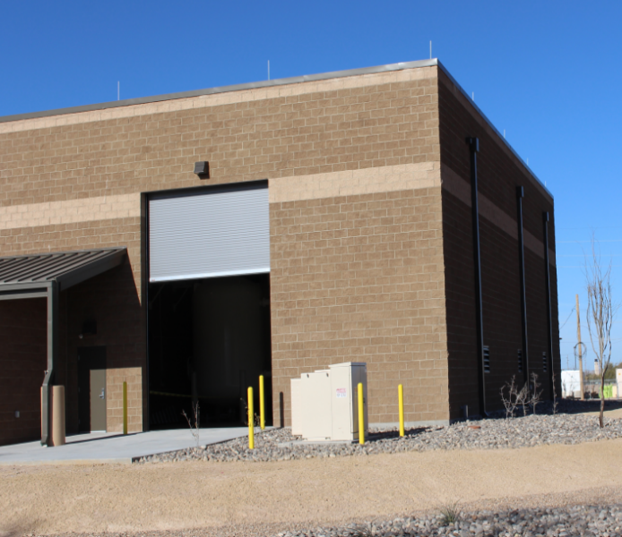
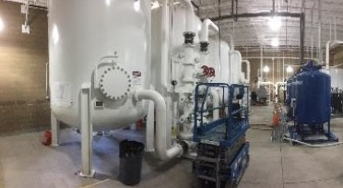
Status update: EDB Interim Measure
Over 1.5 billion gallons of groundwater have been treated, to date, using granular activated carbon to remove EDB to levels at, or below, federal drinking water standards
Groundwater is treated in much the same way that a filter removes dissolved contaminants in a pitcher of drinking water
Groundwater Treatment System (GWTS) on Kirtland AFB

Slide 7
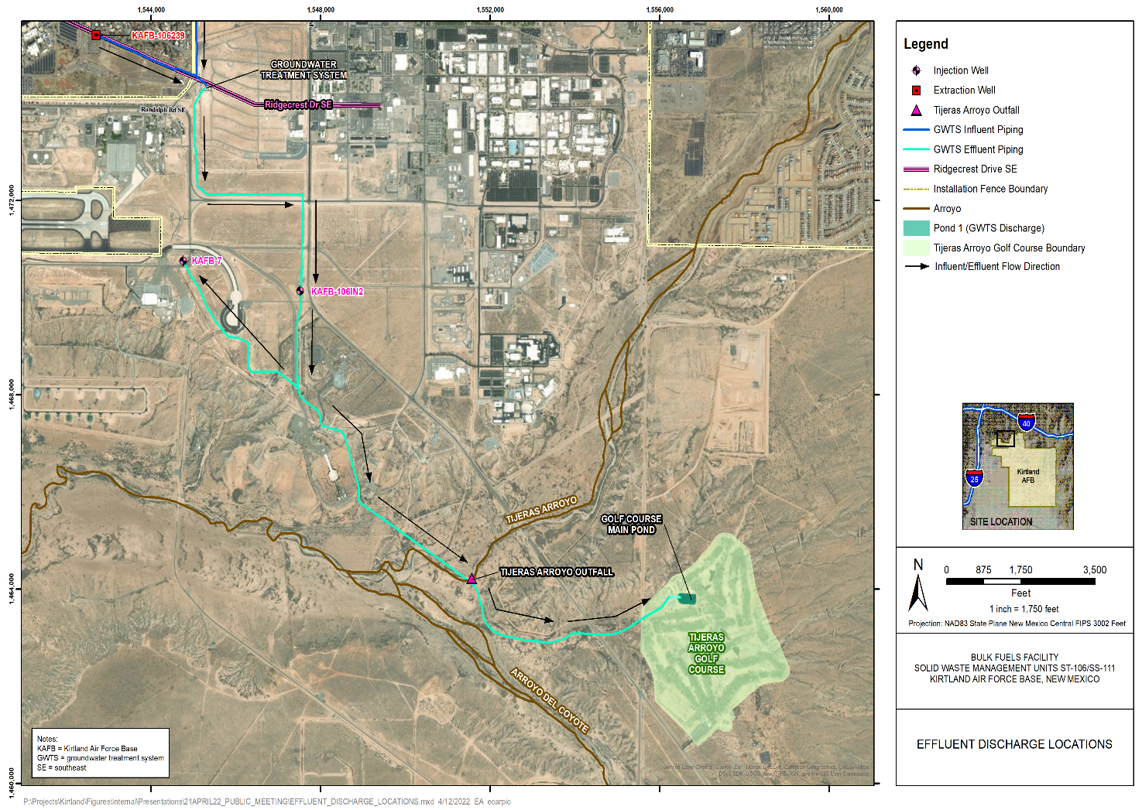
Treated Groundwater Discharge Locations

Slide 8
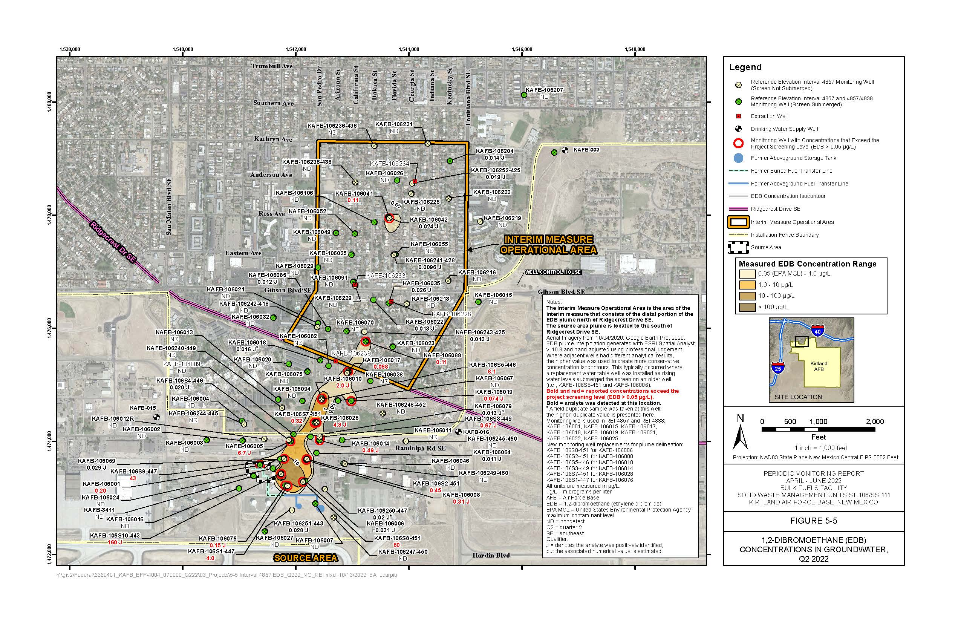
EDB Plume and Monitoring Network

Slide 9
Benzene Plume Stability
Benzene plume located south of Ridgecrest Dr SE
Benzene plume has been stable and does not threaten drinking water wells (no current complete exposure pathway)
*Plume maps are based on actual measurements and not simulations

Slide 10
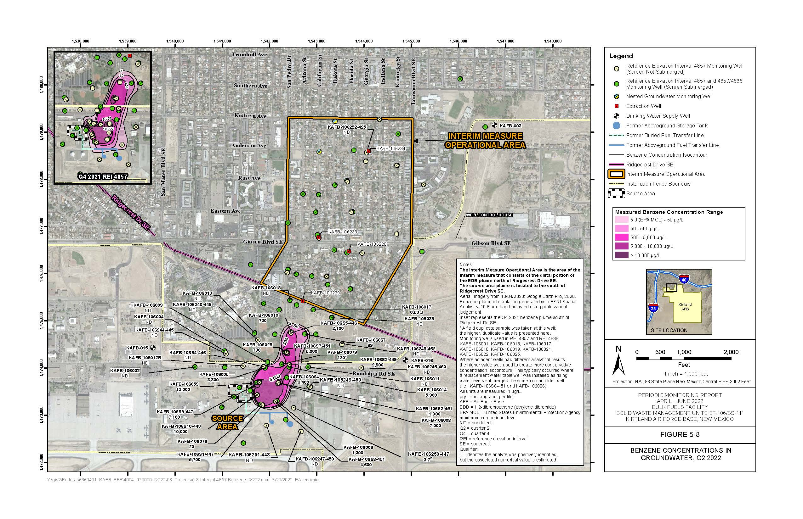
Benzene Plume and Monitoring Network
Add Benzene Plume Figure 5-8 from report; remove REI from title and image
Per TWG Summary, we will include the quarterly reports unaltered.

Slide 11
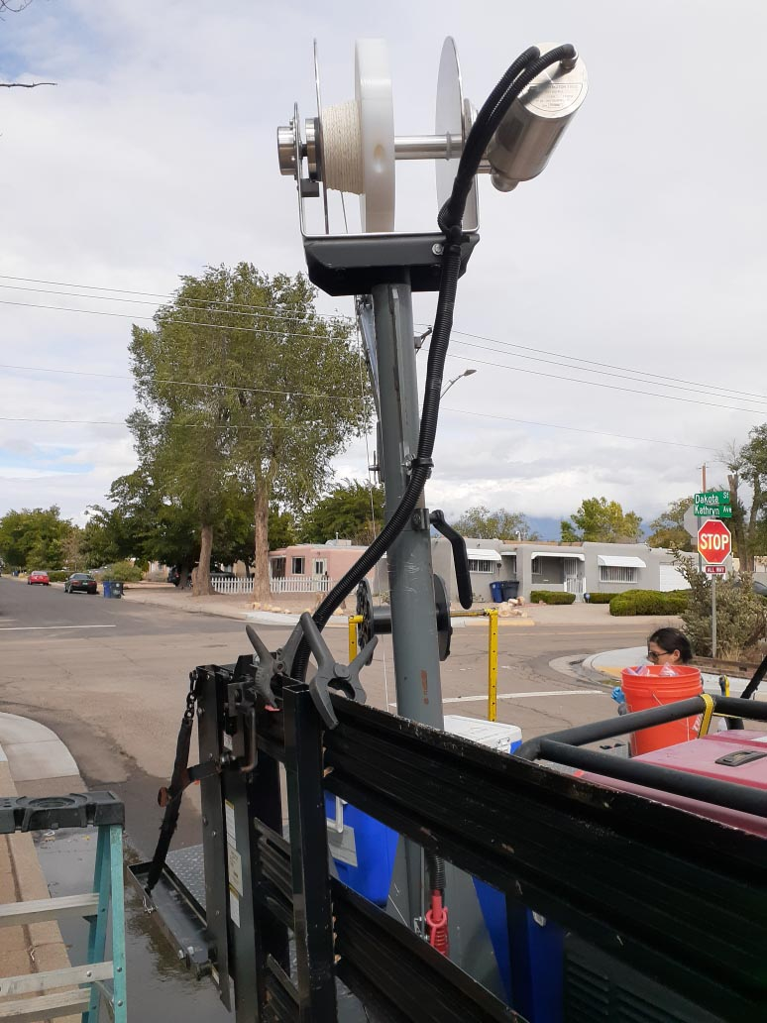
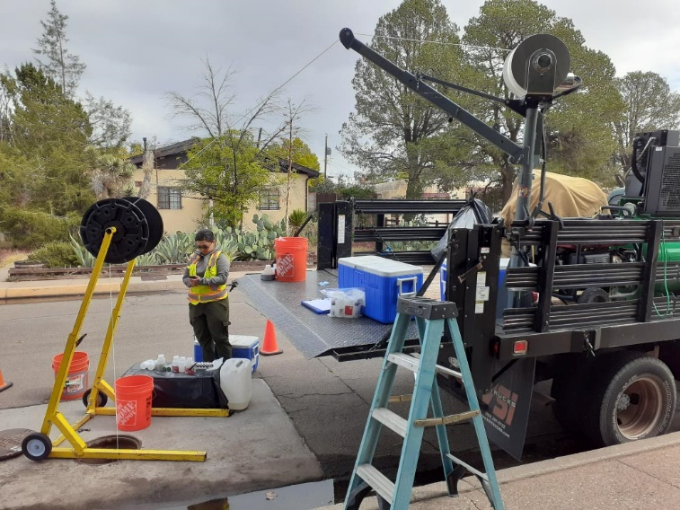
Groundwater Monitoring Activities
Collecting a groundwater sample with passive sampling
Passive sampling apparatus

Slide 12
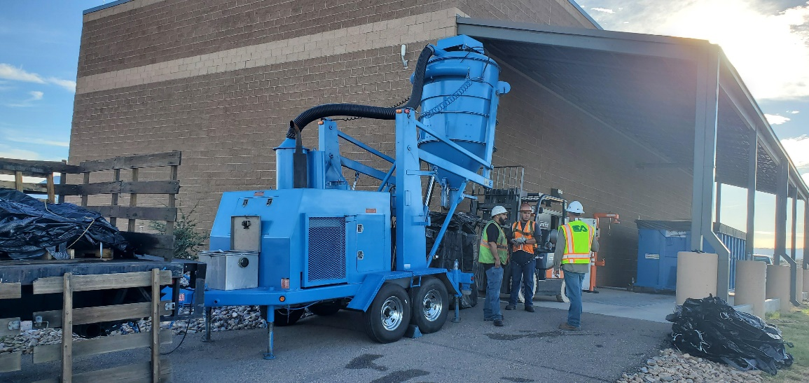
Groundwater Treatment System Activities
Preparation for carbon change out at the groundwater treatment system
Notes:
Train 1 and 2 changed out

Slide 13
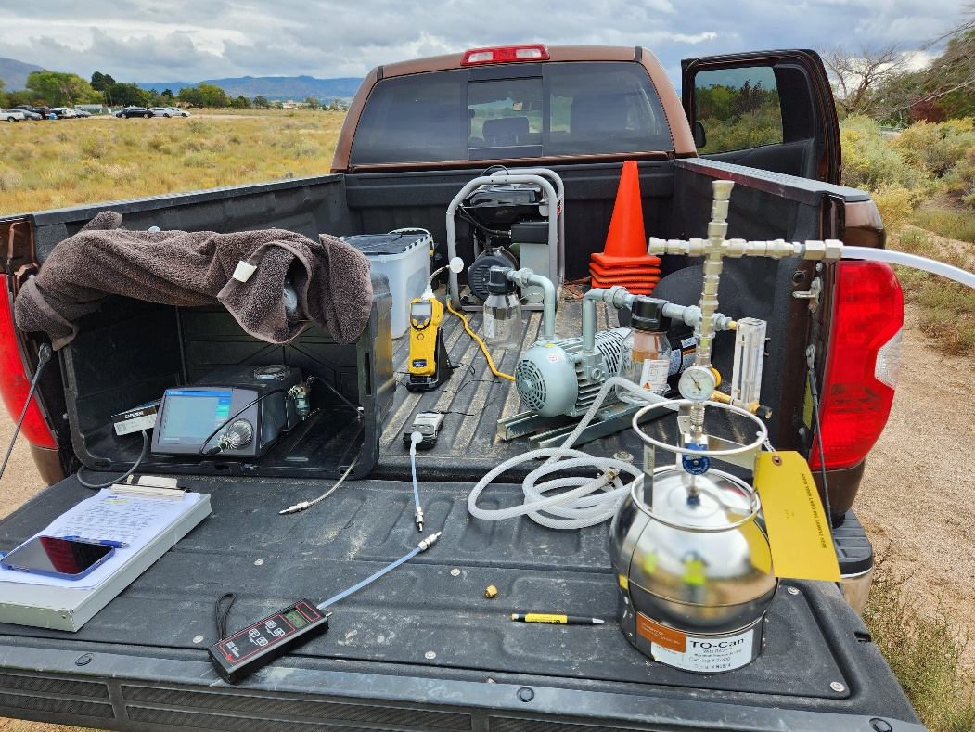
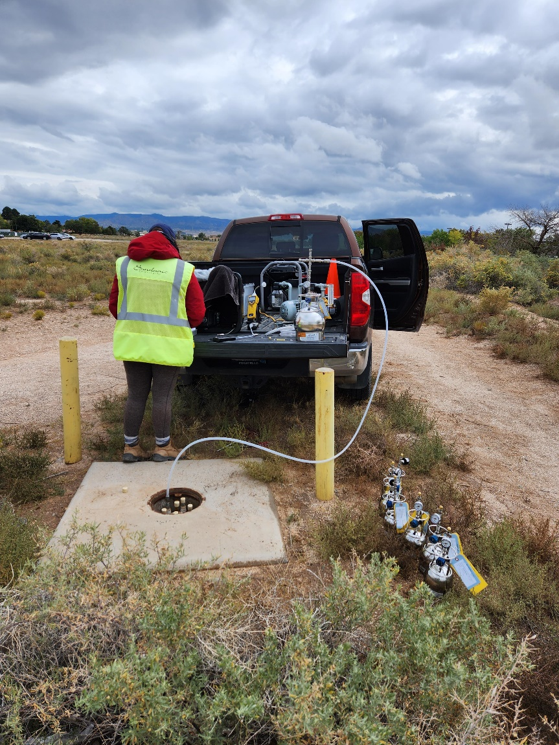
Soil Vapor Sampling Activities
Soil vapor sampling apparatus
Collecting a soil vapor sample

Slide 14
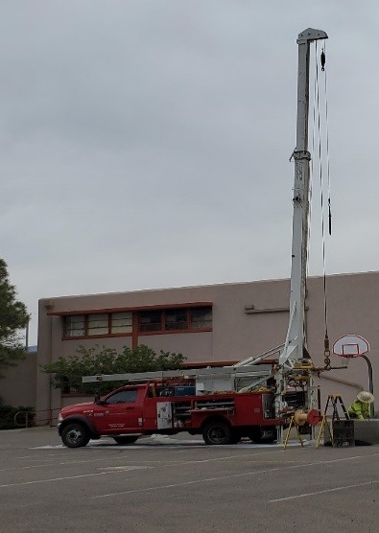
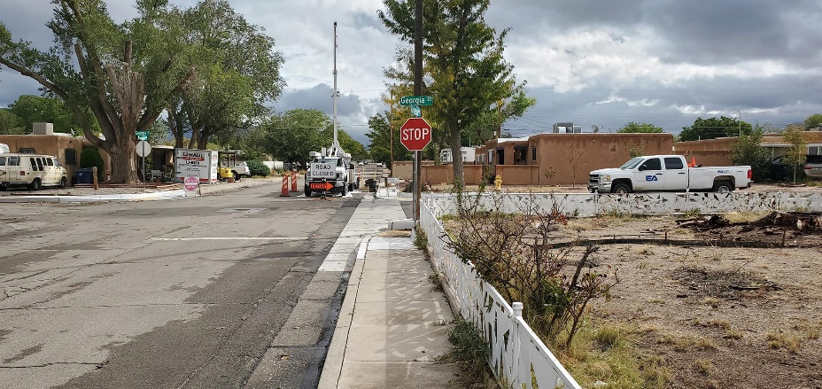
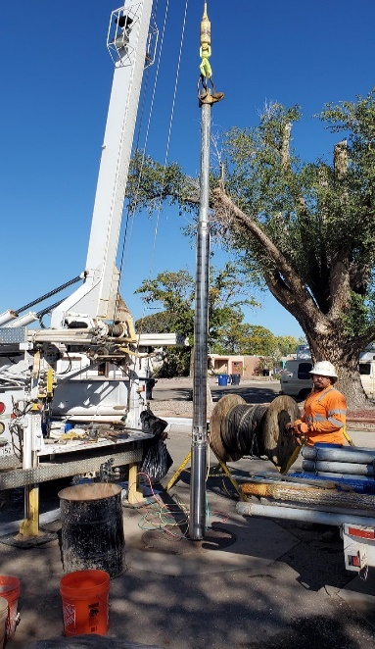
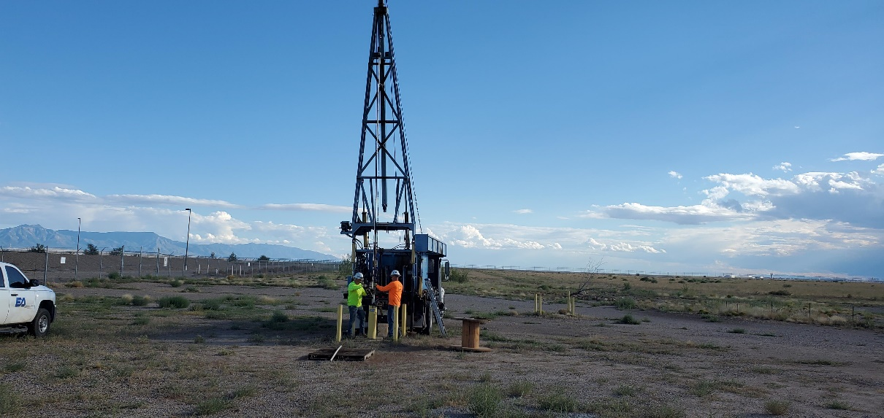
Well Maintenance Activities
KAFB-106228 pump repair
Extraction well KAFB-106234 pump replacement
10-foot stinger attached to groundwater monitoring pump
Performing pump stinger installation
Extraction well KAFB-106234 pump replacement

Slide 15
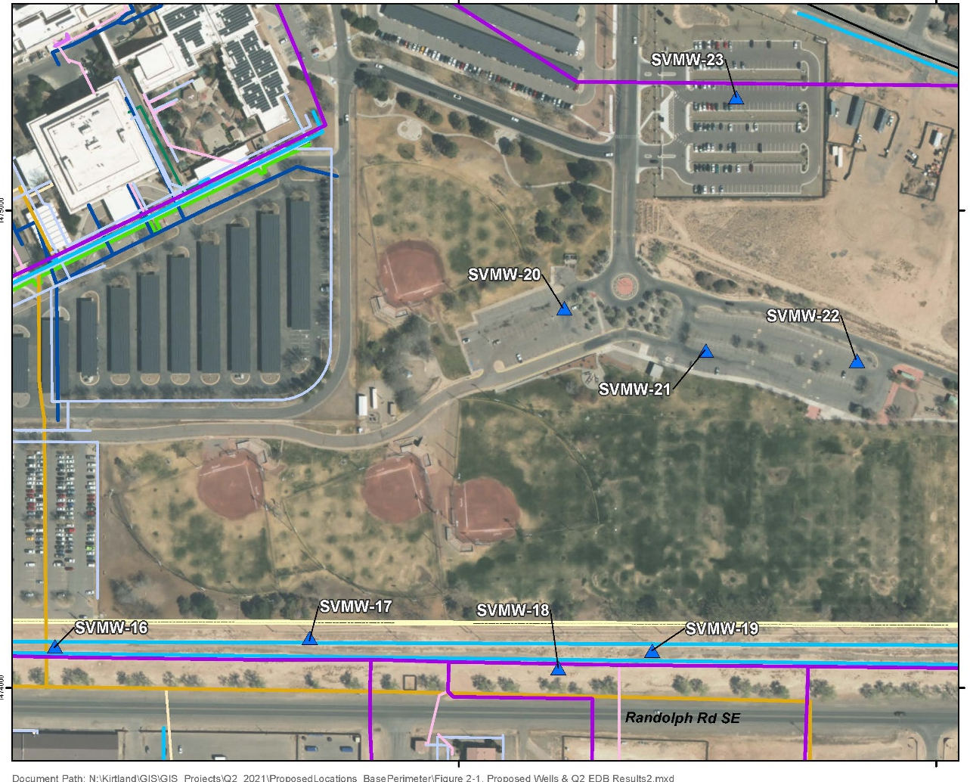
Shallow Soil Vapor Monitoring Well Installation and Sampling
SVMP-23
Eight soil vapor monitoring wells (SVMWs) were installed in February 2022
Each SVMW has nested screens at 5, 10, and 15-foot depths
Winter sampling was completed in early March 2022 and Summer sampling was completed in August 2022
Initial review of data show all results below NMED screening levels for fuel related analytes evaluated
Final report will be submitted to NMED by March 2023
Data is intended to be utilized in an updated Risk Assessment
SVMWs will be incorporated into routine monitoring with the 59 other nested vapor wells by second quarter 2023
US VETERANS
AFFAIRS HOSPITAL
SVMP-20
SVMP-22
SVMP-21
USS BULLHEAD MEMORIAL PARK
SVMP-17
SVMP-18
SVMP-19
SVMP-16

Slide 16
Soil Vapor Monitoring Points

Slide 17
Upcoming Activities
Scheduled for 2023 or underway
Continue to operate and maintain the Groundwater Treatment System
Continue routine groundwater and soil vapor monitoring
174 wells for groundwater monitoring in Q2/Q4
71 wells for groundwater monitoring in Quarter 1 (Q1)/Quarter 3 (Q3)
67 nested soil vapor monitoring wells (323 vapor points) monitoring in Q2/Q4
Kirtland AFB will continue to work with New Mexico Environment Department to complete site investigation phase of the project (Phase II RFI Report) in order to move towards site clean-up of the source area (Corrective Measures Evaluation)

Slide 18
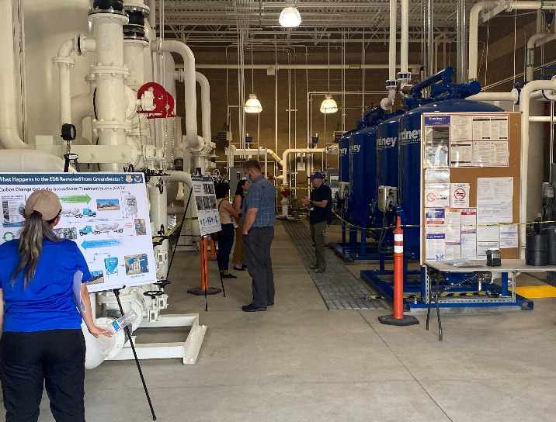
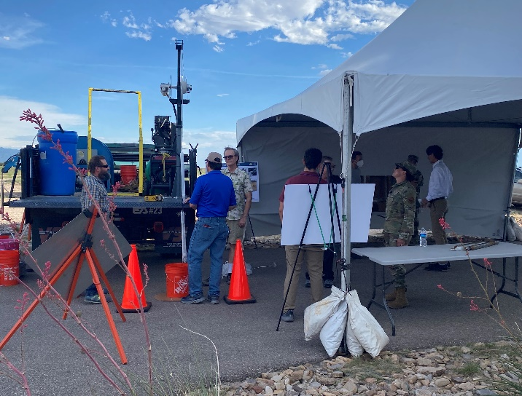
Community Outreach
The AFCEC Administrative Record is up to date. We encourage the public to access the record. Simply type https://ar.afcec-cloud.af.mil/ into your browser, select “Kirtland AFB” from the scroll down menu, and then select “search”.
Or go to Kirtland AFB environmental page: https://www.kirtland.af.mil/Home/BFF/

Slide 19
Questions?
Point of Contact:
Ryan Wortman, Physical Scientist, - ryan.wortman.3@us.af.mil
Ashley Palacios, Public Affairs, – ashley.palacios@us.af.mil
Kirtland AFB Public Affairs, (505) 846-5991 - 377ABW.PA@us.af.mil
Additional information:
Online at https://www.kirtland.af.mil/Home/BFF/ and https://ar.afcec-cloud.af.mil/ or visit our New Information Station at the New Mexico Veterans Memorial at 1100 Louisiana Blvd SE, Albuquerque, NM

