Slide 1
Kirtland Air Force Base 377th Air Base Wing AEP Summary Update
Ms. Cindy Dominguez-Trujillo
November 2022

Slide 2
Overview
377th ABW Data
377th ABW Ethnicity
377th ABW Race
377th ABW Hires
377th ABW Promotions
377th ABW Ethnicity by Pay Grade
ACQ Demo Ethnicity by Pay Grade
377th ABW Gender
377th ABW by Pay Grade
ACQ Demo by Pay Grade
377th ABW Disability
377 ABW Outreach

Slide 3
377th ABW Data
Includes:
General Schedule (GS) employees within and/or serviced by the Wing
Acquisition Workforce Personnel Demonstration Project employees serviced by the Wing
Wage Grade (WG) employees within and/or serviced by the Wing
Permanent/Temporary/Term appointments
Permanent/Temporary promotions

Slide 4
377th ABW Data
Demographics do not include:
AFRL
DTRA
NNSA
Military population

Slide 5
377th ABW Ethnicity

Slide 6
377th ABW Race

Slide 7
377th ABW Hires

Slide 8
377th ABW Promotions

Slide 9
377th ABW Ethnicity by Pay Grade

Slide 10
ACQ Demo Ethnicity by Pay Grade

Slide 11
377th ABW Gender

Slide 12
377th ABW by Pay Grade

Slide 13
ACQ Demo by Pay Grade

Slide 14
377th ABW Disability

Slide 15
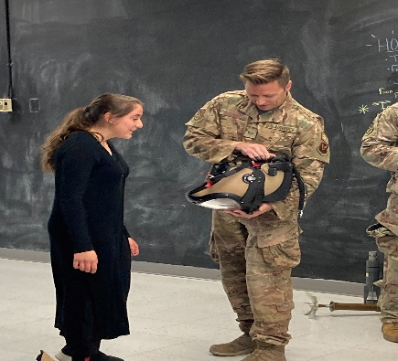
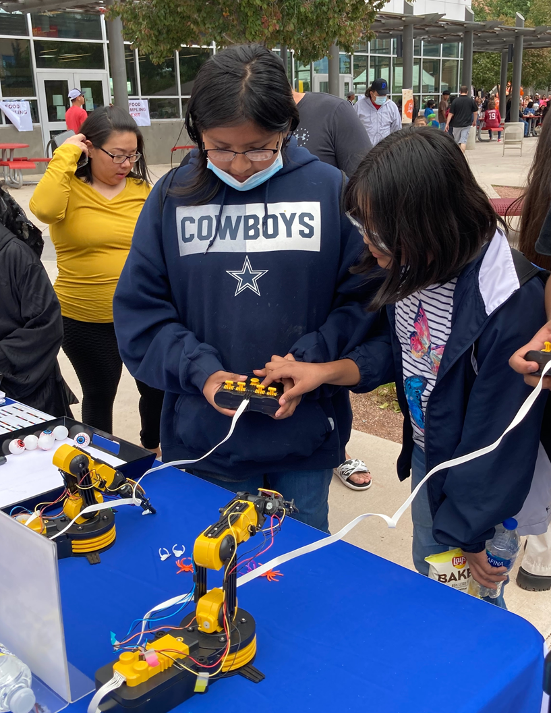
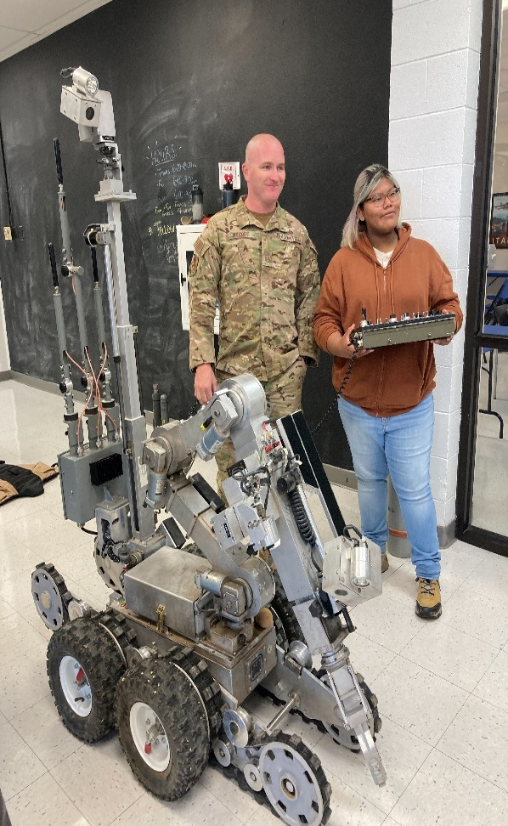
377th ABW Outreach
Career Outreach:
Albuquerque Reads To You
Albuquerque Public Schools
Greater Albuquerque Chamber of Commerce
Big Brothers/Big Sisters
STEAM Discovery Festival
Mentoring program
Best Buddies Employment opportunities for individuals with IDD
Junior Achievement
Bernalillo/Corrales Elementary
Work readiness, Financial literacy, and entrepreneurship skills
National Museum of Nuclear Science STEAM Day

Slide 16
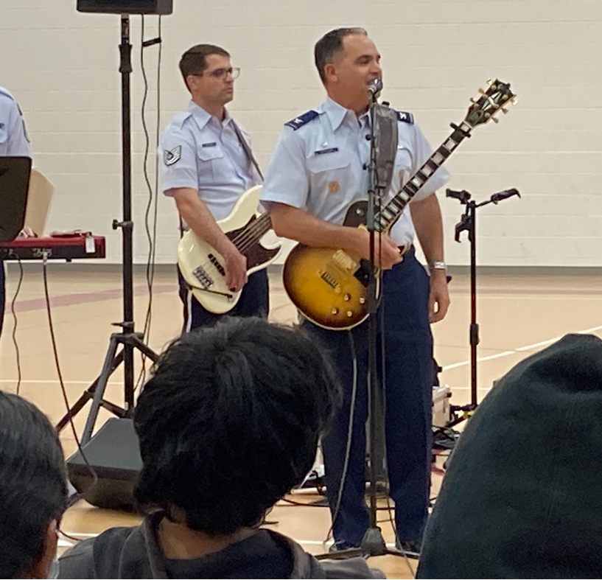
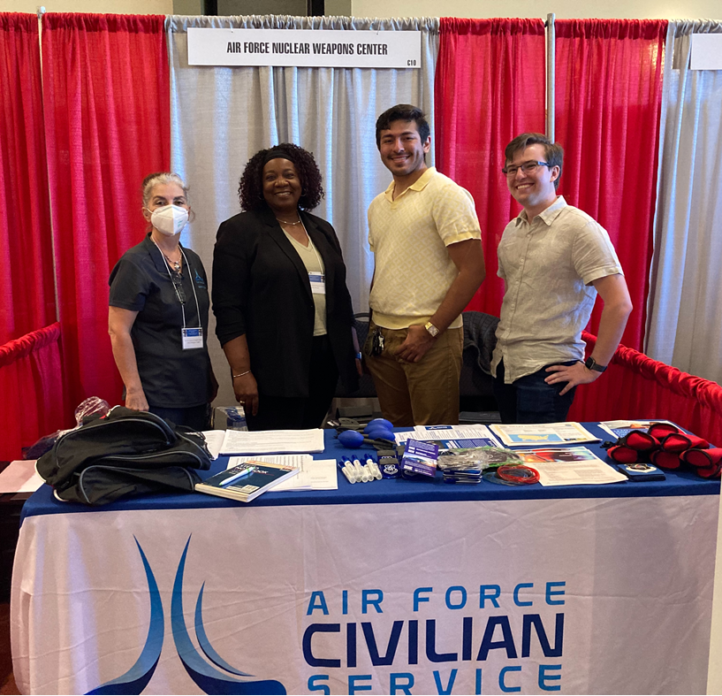
377th ABW Outreach
Career Outreach:
University of New Mexico
New Mexico Tech
New Mexico State University
APS Career Fair –Native Americans
West Mesa High School
Sandia High School
Rio Grande High School
Manzano High School
Bernalillo High School
Van Buren Middle School
Mark Twain Elementary
West Side Community Center
Jobs for Americas Graduates –Development Conference
Mock Interviews
Other:
Hispano Chamber of Commerce Scholarship Committee

Slide 17
377th ABW Outreach

Slide 18
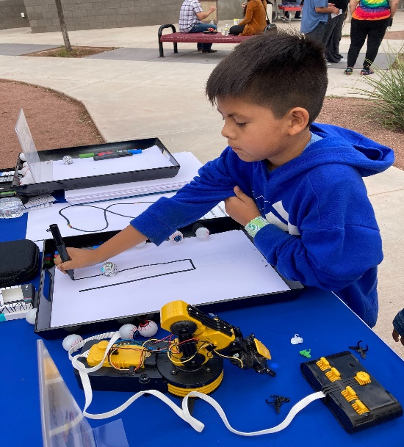
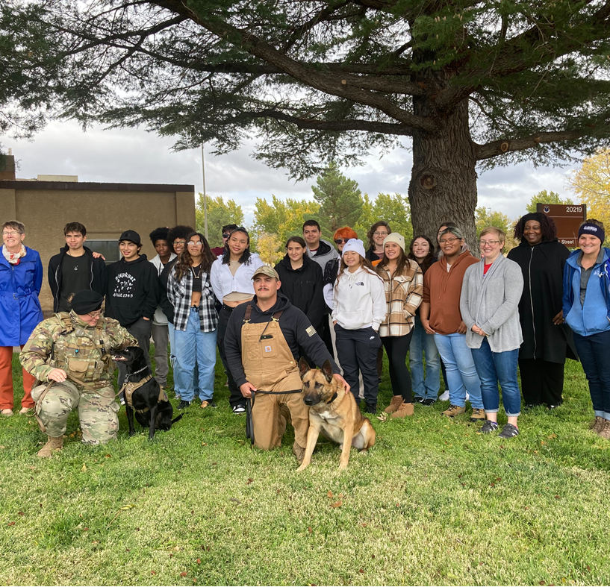
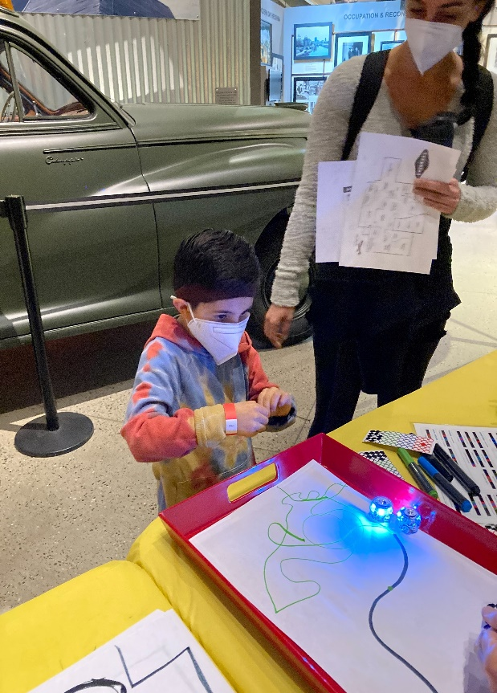
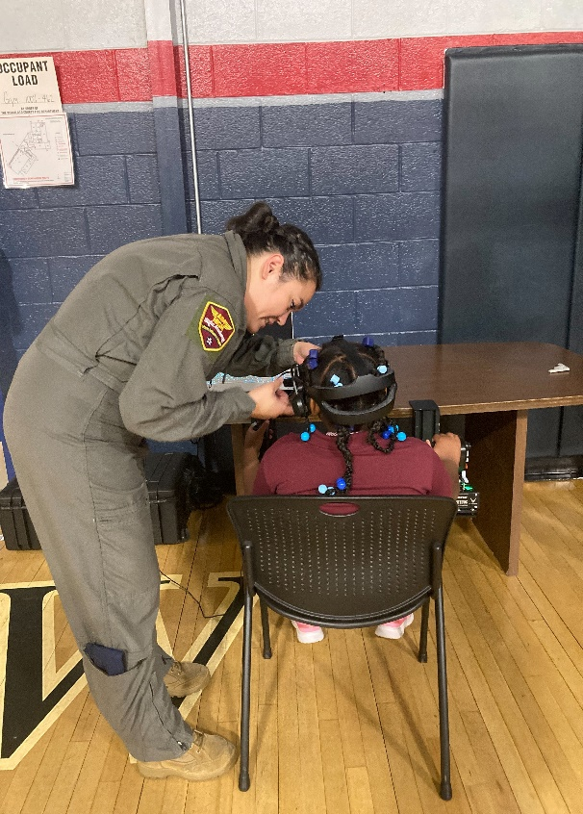
Cindy Dominguez-Trujillo Cynthia Dominguez-Trujillo@us.af.mil (505) 846-1041

Slide 19
Back-Up Slides

Slide 20
377th Acquisition Demo
“The purpose of the project is to demonstrate that the effectiveness of DoD acquisition can be enhanced by allowing greater managerial control over personnel processes and functions and, at the same time, expand the opportunities available to employees through a more responsive and flexible personnel system. This project not only provides a system that retains, recognizes, and rewards employees for their contribution, but also supports their personal and professional growth.”
Section II A of the Federal Register

Slide 21
377th ACQ Demo Pay Scale
BUSINESS AND TECHNICAL MANAGEMENT PROFESSIONAL (NH)
I $20,172* – 36,116 (GS 1- 4) | II $31,083 – 74,074 (GS 5 – 11) | III $68,299 – 105,579 (GS 12 – 13) | IV $95,973- 146,757 (GS 14 – 15)
TECHNICAL MANAGEMENT SUPPORT (NJ)
I $20,172* – 36,116 (GS 1- 4) | II $31,083 – 55,430 (GS 5 – 8) | III $47,097 – 74,074 (GS 9 – 11) | IV $68,299 –105,579 (GS 12 – 13)
ADMINISTRATIVE SUPPORT (NK)
I $20,172* – 36,116 (GS 1-4) | II $31,083 – 50,050 (GS 5 – 7) | III $42,641 – 67,425 (GS 8 – 10)
2022 ACQDEMO
Basic Pay Range Tables with 2.2% GPI (not including locality pay)
*Pay setting must be in compliance with E.O. 14003 protecting the Federal Workforce requiring a $15 per hour minimum pay rate for Federal employees. For 2022, this would be a minimum of $31,305 in the AcqDemo Adjusted Basic Pay (basic pay plus locality pay).

